Slide 1
Functional Dependencies and Normalization for Relational Databases

Slide 2
Relational Database Designs
There are many different relational database "designs" (schemas) that can be used to store the relevant mini-world information.
Can one schema be much better than another?
Notes:
Relational database design is the topic of identifying and selecting a good relational schema for an application.

Slide 3
Example: Shipment of Parts
Consider a database containing shipments of parts from suppliers.
A supplier belongs to a particular city and a status is associated with each city.
A part has a name, color, quantity and weight and is shipped on particular date
Proposed relation to capture this information:
Ship(S#, sname, status, city, P#, pname, colour, weight, qty, date)
Notes:
Student application information:
ID and name
Applying to one or more campuses
Played zero or more sports in high school
Attended one or more high schools
(Assume students played the same sports at every high school attended.)
Proposed relation to capture this information:
Apply(ID, name, campus, sport, HScode, HScity)

Slide 4
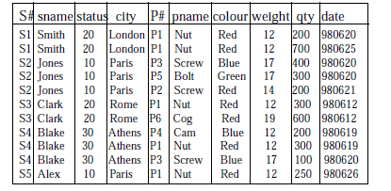
Example: Shipment of Parts
Ship(S#, sname, status, city, P#, pname, colour, weight, qty, date)
Problems ??
Redundant Data
Inability to represent certain information
Loss of information
Notes:
Consider "Mary" (ID 123)
Who is applying to Berkeley and Santa Cruz.
She played tennis, basketball, and volleyball at both of her high schools,
Her high schools are Gunn (code 26) and Menlo-Atherton (code 28).
Question: How many tuples in the relation?

Slide 5
Example: Shipment of Parts
Ship(S#, sname, status, city, P#, pname, colour, weight, qty, date)
INSERT
We can not enter a new supplier until the supplier ships a part.
We can not enter a new part until it is shipped by a supplier.
DELETE
If we delete the only tuple of a particular supplier, we destroy not only the shipment information.
UPDATE
The city of a supplier may appear many times in Ship.
If we change the value of the city in one tuple but not all the other, it creates inconsistency in the database.
Notes:
DELETE
If we delete the only tuple of a particular supplier, we destroy not only the shipment information but also the information that the supplier is from a particular city. (example S5 and P1)

Slide 6
Design Anomalies
Ship(S#, sname, status, city, P#, pname, colour, weight, qty, date)
This Apply relation exhibits three types of anomalies:
Redundancy
Update Anomaly
Deletion Anomaly
Good designs:
No anomalies
Can reconstruct all original information

Slide 7
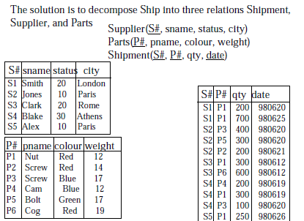
Example: Shipment of Parts

Slide 8
Example: Shipment of Parts
Supplier(S#, sname, status, city) Parts(P#, pname, color, weight)
Shipment(S#, P#, qty, date)
INSERT
DELETE
UPDATE
Problems ??
Notes:
INSERT
We can not enter the fact that a particular city has a particular status until we have a supplier from that city
DELETE
If we delete the only tuple with a particular city, we destroy not only the supplier information but also the information that that city has that particular status.
UPDATE
If we change the status for Paris, we have to change it for all tuples with Paris as the city or we face inconsistency.
If we change the status for Paris, we have to change it for all tuples with Paris as the city or we face inconsistency.
Because
The city of a supplier may appear many times in Supplier .

Slide 9
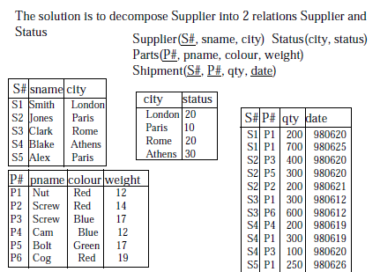
Example: Shipment of Parts

Slide 10
Informal Design Guidelines for Relational Databases
We first discuss informal guidelines for good relational design
Then we discuss formal concepts of functional dependencies and normal forms

Slide 11
Semantics of the Relation Attributes
Each tuple in a relation should represent one entity or relationship instance.
EMP_PROJ(Emp#, Proj#, Ename, Pname, No_hours)
Attributes of different entities should not be mixed in the same relation
Only foreign keys should be used to refer to other entities
Entity and relationship attributes should be kept apart as much as possible.

Slide 12
Redundant Information in Tuples and Update Anomalies
EMP_PROJ(Emp#, Proj#, Ename, Pname, No_hours)
Information is stored redundantly
Wastes storage
Causes problems with update anomalies
Insertion anomalies
Deletion anomalies
Modification anomalies

Slide 13
EXAMPLE : Redundant Information
EMP_PROJ(Emp#, Proj#, Ename, Pname, No_hours)
Insert Anomaly
Delete Anomaly
Update Anomaly
Notes:
Update Anomaly:
Changing the name of project number P1 from “Billing” to “Customer-Accounting” may cause this update to be made for all 100 employees working on project P1.
Insert Anomaly:
Cannot insert a project unless an employee is assigned to it.
Cannot insert an employee unless a he is assigned to a project
Delete Anomaly:
When a project is deleted, it will result in deleting all the employees who work on that project.
Alternately, if an employee is the sole employee on a project, deleting that employee would result in deleting the corresponding project.

Slide 14
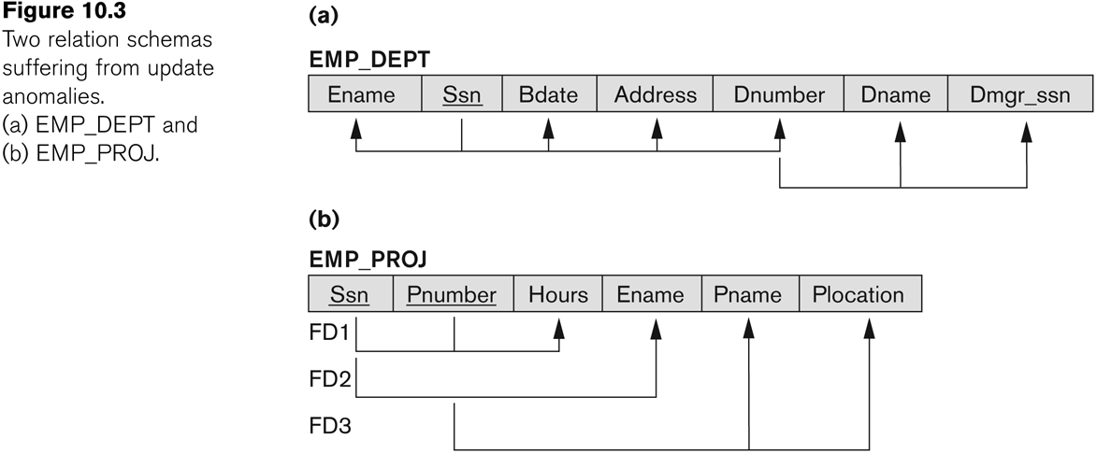
Two relation schemas suffering from update anomalies

Slide 15
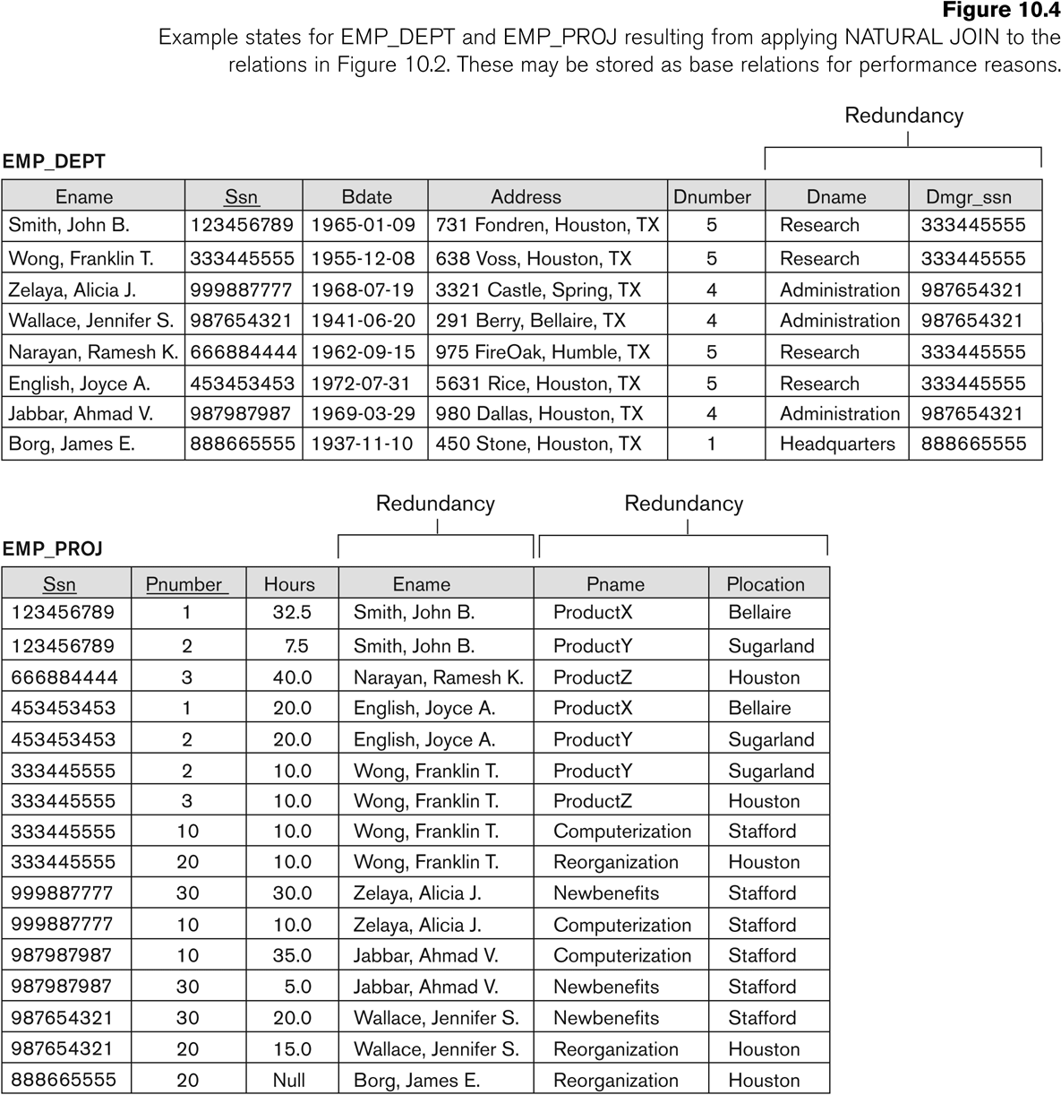

Slide 16
Redundant Information in Tuples and Update Anomalies
Design a schema that does not suffer from
insertion,
deletion and
update anomalies.

Slide 17
Null Values in Tuples
Relations should have few NULL values
Attributes that are NULL frequently could be placed in separate relations (with the primary key)
Reasons for nulls:
Attribute not applicable or invalid
Attribute value unknown (may exist)
Value known to exist, but unavailable

Slide 18
Relation Decomposition
In order to solve the previous problems we decomposed the relations into smaller relations.
Relation decomposition can be dangerous we can loose information.
Loss-less join decomposition
If we decompose a relation R into smaller relations, the join of those relations should return R, not more, not less.

Slide 19
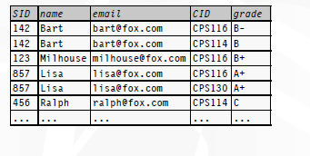
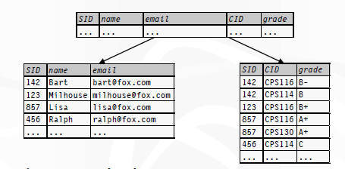
Example: Relation Decomposition
Redundant Information
Eliminates redundancy
To get back to the original relation use join

Slide 20
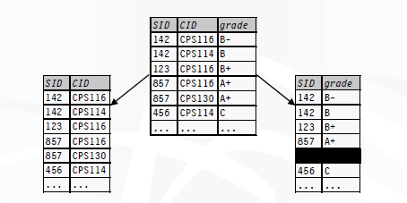
Bad decomposition
Association between CID and grade is lost
Join returns more rows than the original relation

Slide 21
Spurious Tuples
Bad designs for a relational database may result in erroneous results for certain JOIN operations
Relations should satisfy the lossless join condition.
No spurious tuples should be generated by doing a natural-join of any relations.

Slide 22
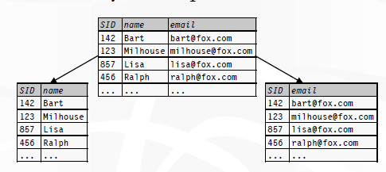
Unnecessary decomposition
Join returns the original relation
Unnecessary: no redundancy is removed, and now SID is stored twice!

Slide 23
Functional Dependencies

Slide 24
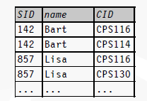
Motivation
How do we tell if a design is bad?
This design has redundancy and update anomalies
How about a systematic approach to detecting and removing redundancy in designs?
Dependencies, decompositions, and normal forms

Slide 25
Functional Dependencies
Functional dependencies play an important role in database design.
They describe relationships between attributes.
FDs are derived from the real-world constraints on the attributes

Slide 26
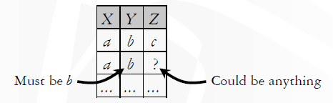
Functional Dependencies
A functional dependency (FD) has the form X → Y, where X and Y are sets of attributes in a relation R
X → Y means that whenever two tuples in R agree on all the attributes in X, they must also agree on all attributes in Y
We say X functionally determines Y
X -> Y in R specifies a constraint on all relation instances r(R)
For any two tuples t1 and t2
in any relation instance r(R):
If t1[X]=t2[X], then t1[Y]=t2[Y]
Notes:
Dno -> dname
Dno, name, location
CS A
CS B

Slide 27
Example: Student Grade Info
StudentGrade (SID, name, email, CID, grade)
SID → name, email
email → SID
SID, CID → grade
Not a good design

Slide 28
EXAMPLE: ADDRESS
Address (street_address, city, state, zip)
street_address, city, state → zip
zip → city, state
zip, state → zip?
This is a trivial FD
Trivial FD: LHS ⊇ RHS
zip → state, zip?
This is non-trivial, but not completely non-trivial
Completely non-trivial FD: LHS ∩ RHS = ∅

Slide 29
Examples of FD constraints
If K is a key of R, then K functionally determines all attributes in R
SSN -> ENAME
PNUMBER -> {PNAME, PLOCATION}
{SSN, PNUMBER} -> HOURS

Slide 30
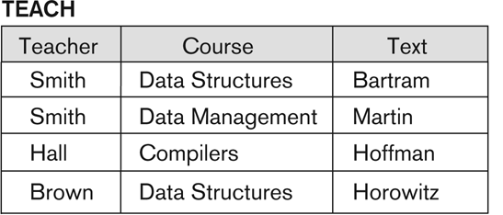
FD is a property of relational schema R. Must be define by someone who knows the semantic of attributes of R.
FD’s hold at all times
Certain FD’s can be ruled out based on a given state of the database
Text -> course
possible FD
Teacher -> course
ruled out

Slide 31
Functional Dependencies
Given a relation R and a set of FD’s F
Does another FD follow from F?
Are some of the FD’s in F redundant (i.e., they follow from the others)?
Example: Emp_Dept(ename, ssn, bdate, address, dnumber, dname, dmgrssn)
F ={ssn -> {ename, bdate, address, dnumber),
dnumber ->{dname, dmgrssn) }
Additional FD that can be infer from F
ssn-> dname, dmgrssn
ssn-> ssn
dnumber -> dname

Slide 32
Inference Rules for FDs
Given a set of FDs F, we can infer additional FDs that hold whenever the FDs in F hold
Armstrong's inference rules:
IR1. (Reflexive)
If Y ⊆ X, then X -> Y
IR2. (Augmentation)
If X -> Y, then XZ -> YZ
(XZ stands for X U Z)
IR3. (Transitive)
If X -> Y and Y -> Z, then X -> Z
IR1, IR2, IR3 form a sound and complete set of inference rules

Slide 33
Inference Rules for FDs
Some additional inference rules that are useful:
Decomposition:
If X -> YZ, then X -> Y and X -> Z
Union:
If X -> Y and X -> Z, then X -> YZ
Pseudotransitivity:
If X -> Y and WY -> Z, then WX -> Z
The last three inference rules, as well as any other inference rules, can be deduced from IR1, IR2, and IR3 (completeness property)

Slide 34
If X -> YZ, then X -> Y and X -> Z
YZ -> Y (reflexive)
X -> YZ (given)
X -> Y (transitivity)
If X -> Y and X -> Z, then X -> YZ
X ->XY (augmenting X in X-> Y)
XY -> YZ (augmenting Y in X-> Z)
X -> YZ (transitivity)
If X -> Y and WY -> Z, then WX -> Z
WX->WY (augmenting)
WY -> Z (given)
WX -> Z (transitivity)

Slide 35
Inference Rules for FDs
Closure of a set F of FDs is the set F⁺ of all FDs that can be inferred from F
Closure of a set of attributes X with respect to F is the set X⁺ of all attributes that are functionally determined by X
X⁺ can be calculated by repeatedly applying IR1, IR2, IR3 using the FDs in F

Slide 36
Algorithm for computing Attribute Closure
The closure of X (denoted X ⁺) with respect to F is the set of all attributes functionally determined by X
Algorithm for computing the closure
X⁺ = X
repeat
OldX⁺ =X⁺
for each functional dependency Y → Z in F do
if Y⊆ X⁺ then X⁺ := X⁺ ∪ Z
until (X ⁺ = oldX⁺ )

Slide 37
Example 1: Closure Algorithm
Consider following schema
EMP_PROJ(Ssn, Ename, Pno, Pname, Hours)
And FDs
F = {Ssn -> Ename,
Pno -> {Pname, Plocation},
{Ssn, Pno} -> Hours }
Find the following Closure Sets
{Ssn}⁺ =
{Pno} ⁺ =
{Ssn, Pno} ⁺ =
Notes:
{Ssn}⁺ = {Ssn, Ename}
{Pno} ⁺ = {Pno, Plocation, Pname}
{Ssn, Pno} ⁺ = {Ssn, Ename, Pno, Pname, Hours}

Slide 38
Example 2: Closure Algorithm
StudentGrade (SID, name, email, CID, grade)
F includes:
SID → name, email
email → SID
SID, CID → grade
{ CID, email }⁺ = ?
X+ = {CID, email}
Consider email → SID
X+ = {SID, CID, email}
Consider SID → name, email
X+ = {SID, CID, email, name}
Consider SID, CID → grade
X+ = {SID, CID, email, name, grade}

Slide 39
Using rules of FD’s
Given a relation R and set of FD’s F
Does another FD X → Y follow from F?
Use the rules to come up with a proof
Example F includes:
SID → name, email; email → SID; SID, CID → grade
CID, email → grade?
email → SID (given in F)
CID, email → CID, SID (augmentation)
SID, CID → grade (given in F)
CID, email → grade (transitivity)

Slide 40
Minimal Sets of FDs
A set of FDs is minimal if it satisfies the following conditions:
Every dependency in F has a single attribute for its RHS.
We cannot replace any dependency X -> A in F with Y -> A, Y ⊆ X and still have a set of dependencies that is equivalent to F.
We cannot remove any dependency from F and have a set of dependencies that is equivalent to F.
Every set of FDs has an equivalent minimal set
There can be several equivalent minimal sets

Slide 41
Example: Minimal Cover
F = { AB -> C, C -> A, BC -> D, ACD -> B, D -> EG, BE -> C, CG -> BD, CE -> AG}
Step1: Canonical Form
Step 2: We need to look for redundant attributes on the LHS
Step3: We need to look for FDs that are redundant

Slide 42
Example: Minimal Cover
For STEP 2: apply either of the rules below to find redundant attributes on the LHS:
1. In an FD {X → A} from set F, attribute B ∈ X is redundant in X if F logically implies
(F – {X → A}) ∪ {(X – B) → A}.
2. To test if attribute B ∈ X is redundant in X
Step 1: compute ({X} – B)+ using the dependencies in F
Step 2: check that ({X} – B)+ contains B; if it does, B is redundant

Slide 43
Example: Minimal Cover
Consider ACD -> B to see if any of the three attributes on the LHS is redundant
Computing CD+ ={ACDEGB}
Closure contains A and thus, A is redundant.
The closure contains B, which tells us that CD -> B holds.
Alternatively, we need to prove that F logically implies CD -> B in place of ACD -> B.
C -> A (given in F)
CD -> ACD (augment with CD)
ACD -> B (given in F)
CD -> B (transitivity)

Slide 44
Example: Minimal Cover
Step3: Look for redundant FDs in set F.
CE -> A
CG -> B
(as CG -> D, and CD -> B in F.)
No more redundant FDs in F.
Minimal Cover : {AB -> C, C -> A, BC -> D, CD -> B, D -> E, D -> G, BE -> C, CG -> D, CE -> G}

Slide 45
Example: Minimal Cover
Minimal Cover 2 : {AB -> C, C -> A, BC -> D, D -> E, D -> G, BE -> C, CG -> B, CE -> G}
Obtained by eliminating redundant FDs,
CE -> A,
CG -> D, (CG->B, BC->D)
CD -> B (D->G, CG->B)
We need one of {CG -> D, CG -> B} in the minimal cover – can not eliminate both.
Notes:
IS CE -> A redundant? Yes, since we have C -> A in F, we can get CE -> A through augmentation.
Is CG -> D redundant? Yes, since CG -> B, BC -> D in F
Is ACD -> B redundant? Yes, since D -> G, CG -> B
The difference between the two covers is
In the first one, we chose to keep CG -> D which helps us to infer CG -> B making it redundant.
In the second one, as we kept CG -> B, we could eliminate CG -> D and CD -> B as redundant.

Slide 46
Algorithm for finding Minimal Cover F for a set of FDs E
Set F:= E
Replace each FD X-> {A1, A2, …, An} in F by n FDs X-> A1, X->A2, … , X-> An
For each FD X-> A in F
For each attribute B of X
if {{ F- { X -> A }} U { (X- B) -> A}} = F
then replace X->A with (X- B) -> A in F
For each remaining FD X->A in F
if {F – {X->A} } = F
then remove X->A from F

Slide 47
Example 2: Compute Minimal Sets of FDs
Consider set of FDs E : {B → A, D → A, AB → D}. We have to find the minimum cover of E.
Step1: Canonical form
Step 2: Determine if AB → D has any redundant attribute?
Consider B → A
BB → AB (augmenting with B -- IR2)
B → AB
AB → D (given)
We get B → D ( transitivity – IR3)
Hence, AB → D may be replaced by B → D.
Now E′ : {B → A, D → A, B → D}.
Notes:
Determine if AB → D has any redundant attribute, that is, can it be replaced by B → D or A → D?

Slide 48
Example 2: Compute Minimal Sets of FDs
Consider set of FDs E : {B → A, D → A, AB → D}. We have to find the minimum cover of E.
E′ : {B → A, D → A, B → D}.
Step 3: Look for a redundant FD in E′
B → D
D → A,
Thus, B → A (transitive rule)
Eliminate B → A in E’.
The minimum cover of E is {B → D, D → A}.

Slide 49
Equivalence of Sets of FDs
Two sets of FDs F and G are equivalent if:
Every FD in F can be inferred from G, and
Every FD in G can be inferred from F
Hence, F and G are equivalent if F⁺ =G⁺
Covers:
F covers G if every FD in G can be inferred from F
(i.e., if G⁺ ⊆ F⁺)
F and G are equivalent if F covers G and G covers F

Slide 50
Example: Equivalence between sets of Functional Dependencies
Consider two sets of FDs, F and G,
F = {A -> B, B -> C, AC -> D} and
G = {A -> B, B -> C, A -> D}
Are F and G equivalent?
We need to prove that F+ = G+.
To show that F covers G calculate X+ w.r.t to F for each FD in G, and then see if this F closure contains attribute in G.
Similarly compute G covers F.
Notes:
This is computationally expensive we take a short cut.
We can conclude that F and G are equivalent, if we can prove that all FDs in F can be inferred from the set of FDs in G and vice versa.

Slide 51
Example: Equivalence between sets of Functional Dependencies
Use attribute closure to infer all FDs in F using G
F = {A -> B, B -> C, AC -> D}
G = {A -> B, B -> C, A -> D}
Take the attributes from the LHS of FDs in F and compute attribute closure for each using FDs in G:
(A+ using G) = ABCD;
(B+ using G) = BC;
(AC+ using G) = ABCD;
All FDs in F are inferred using FDs in G.

Slide 52
Example: Equivalence between sets of Functional Dependencies
F = {A -> B, B -> C, AC -> D}
G = {A -> B, B -> C, A -> D}
Now we see if all FDs in G are inferred by F
A+ using F = ABCD;
B+ using F = BC;
All FDs in F can be obtained from G and vice versa, so we conclude that F and G are equivalent.

Slide 53
Example: Equivalence between sets of Functional Dependencies
F = {A -> B, A ->C}
G = {A -> B, B -> C}
Are F and G equivalent?
A+ using G = ABC;
A+ using F = ABC;
B+ using F = B,
This indicate B -> C in G is not inferred using the FDs from F.
Thus, F and G are not equivalent, because B -> C in G is not inferred from the FDs in F.

Slide 54
Example: Find the Key for Relation R
Consider a relation R= {A,B,C,D,E,F,G,H,I,J} and
The set of FD’s {
A,B -> C ,
B,D->E,F ,
A,D-> G,H ,
A->I ,
H->J }.
Find the key for Relation R with given FD’s.
Notes:
None of the single attribute is the key
None of the pair of the attributes is the key
{A,B,D} is the key
2NF
The first-level partial dependencies on the key (which violate 2NF) are:{A, B} -> {C, I}, {B, D} -> {E, F}, {A, D}+ -> {G, H, I, J}Hence, R is decomposed into R1, R2, R3, R4 (keys are underlined):R1 = {A, B, C, I}, R2 = {B, D, E, F}, R3 = {A, D, G, H, I, J}, R4 = {A, B, D}Additional partial dependencies exist in R1 and R3 because {A} -> {I}. Hence, we remove{I} into R5, so the following relations are the result of 2NF decomposition:R1 = {A, B, C}, R2 = {B, D, E, F}, R3 = {A, D, G, H, J}, R4 = {A, B, D}, R5 = {A, I}Next, we check for transitive dependencies in each of the relations (which violate 3NF).Only R3 has a transitive dependency {A, D} -> {H} -> {J}, so it is decomposed into R31and R32 as follows:
R31 = {H, J}, R32 = {A, D, G, H}The final set of 3NF relations is {R1, R2, R31, R32, R4, R5}

Slide 55
Algorithm: To Find a Key K for R Given a set F of FD’s
Input: A universal relation R and a set of functional dependencies F on the attributes of R.
Set K := R.
For each attribute A in K {
compute (K - A)⁺ with respect to F;
If (K - A)⁺ contains all the attributes in R,
then set K := K - {A};
}

Slide 56
Assignment 6- Functional Dependencies
Will be posted on the group
Notes:
BOOK Edition 5th
10.21
10.22
10.23
10.24
10.26
10.31
10.32

Slide 57
Normalization

Slide 58
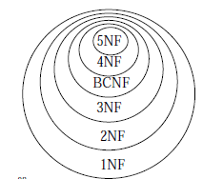
Normalization of Relations
Normalization:
The process of decomposing "bad" relation by breaking it into smaller relations
Normalization should maintain properties like lossless join and dependency preservation to ensure a good relational design (
Notes:
2NF, 3NF, BCNF (based on keys and FDs of a relation schema)
4NF :based on keys, multi-valued dependencies : MVDs.
5NF :based on keys, join dependencies : JDs
Dependency preservation : Each functional dependency should either appear directly in one of the decompose relation or it can inferred from dependencies that appear in some decompose relations

Slide 59
Normal Forms
The database designers don’t have to normalize relations to the highest possible normal form (usually 3NF, BCNF or 4NF is enough)
Denormalization:
Opposite of normalization
Join relations to form a base relation—which is in a lower normal form

Slide 60
SuperKeys and Keys
Superkey
Key
Candidate key
Primary key
Secondary keys
Prime attribute: it must be a member of some candidate key
Nonprime attribute: it is not a member of any candidate key.
Notes:
If relation has more than one key than each key is called Candidate key. One is chosen as primary and rest are secondary keys.

Slide 61
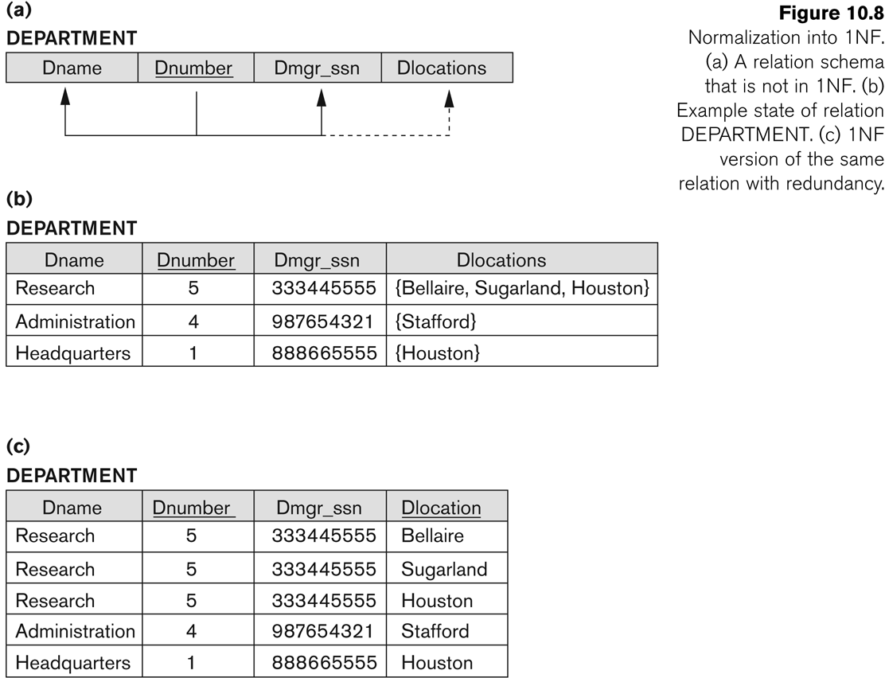
First Normal Form
It disallows Composite attributes, Multivalued attributes and Nested relations
Attributes can have atomic values for an individual tuple
It is considered to be a part of the definition of relation

Slide 62
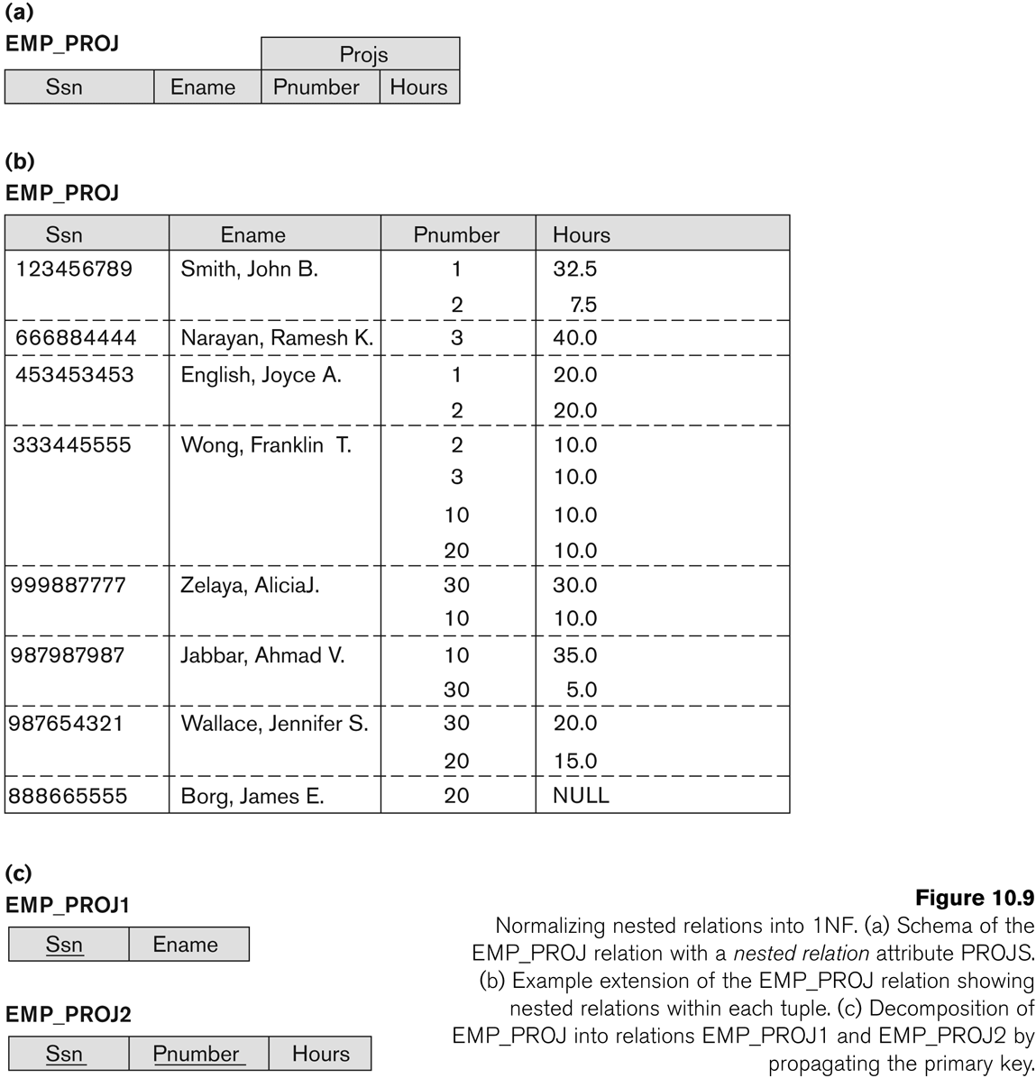
Normalization of nested relations into 1NF

Slide 63
Second Normal Form
Uses the concepts of FDs
Full functional dependency: a FD Y -> Z where removal of any attribute from Y means the FD does not hold any more
EMP_PROJ(SSN, Ename, Pno, Pname, Hours)
{SSN, Pno} -> Hours is a full FD
since neither SSN -> Hours nor Pno -> Hours hold
{SSN, Pno} -> Ename is not a full FD, it is called a partial dependency
since SSN -> Ename also holds
Notes:
Prime attribute: An attribute that is member of the primary key K

Slide 64
Second Normal Form
Second Normal Form:
A relation that is in 1NF and every non-prime attribute is fully functionally dependent on the primary key
We can decompose a relation into 2NF relations via the process of 2NF normalization

Slide 65
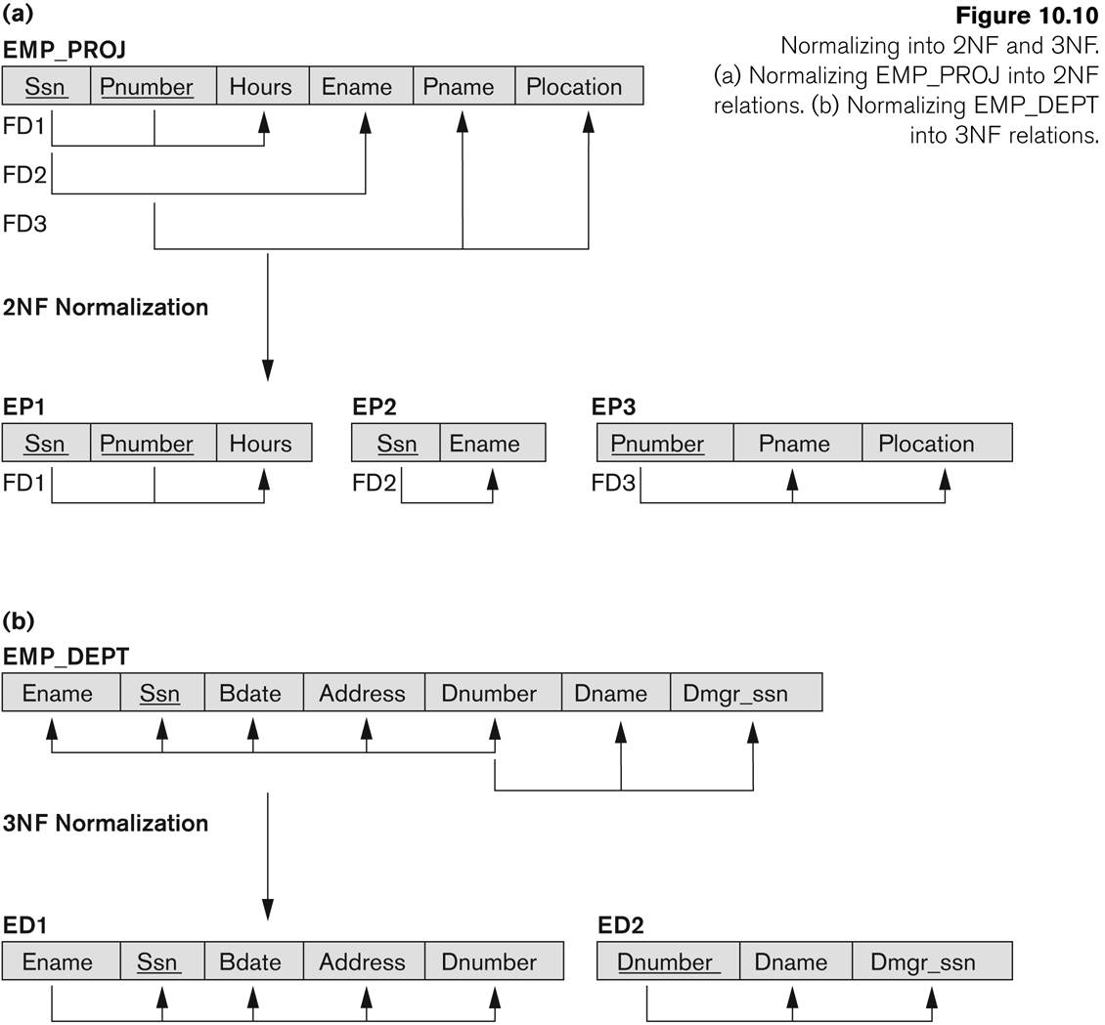
Normalizing into 2NF
Notes:
Test for FD where LHS attributes are part of primary key
If PK is single attribute then test need not to be applied

Slide 66
Third Normal Form
Transitive functional dependency:
a FD X -> Z that can be derived from two FDs X -> Y and Y -> Z
Emp_Dept(SSN, Ename, Bdate, Address, Dno, Dname, Dmgrs_ssn)
SSN -> DMGRSSN is a transitive FD
Since SSN -> DNUMBER and DNUMBER -> DMGRSSN hold
SSN -> ENAME is non-transitive
Since there is no set of attributes X where SSN -> X and
X -> ENAME

Slide 67
Third Normal Form
Third Normal Form:
A relation that is in 2NF, and in which no non-prime attribute is transitively dependent on the primary key.

Slide 68
Third Normal Form
NOTE:
In X -> Y and Y -> Z, with X as the primary key, we consider this a problem only if Y is not a candidate key.
Consider EMP (SSN, Emp#, Salary ).
Here, SSN -> Emp# -> Salary and Emp# is a candidate key.
When Y is a candidate key, there is no problem with the transitive dependency

Slide 69
Normal Forms Defined Informally
1st normal form
All attributes depend on the key
2nd normal form
All attributes depend on the whole key
3rd normal form
All attributes depend on nothing but the key
Notes:
Intuitivily we can see that any FD in which LHS is a part of PK or any FD in which LHS is a non key attribute is a problematic and 2nd and 3rd Normal form reform such FD’s

Slide 70
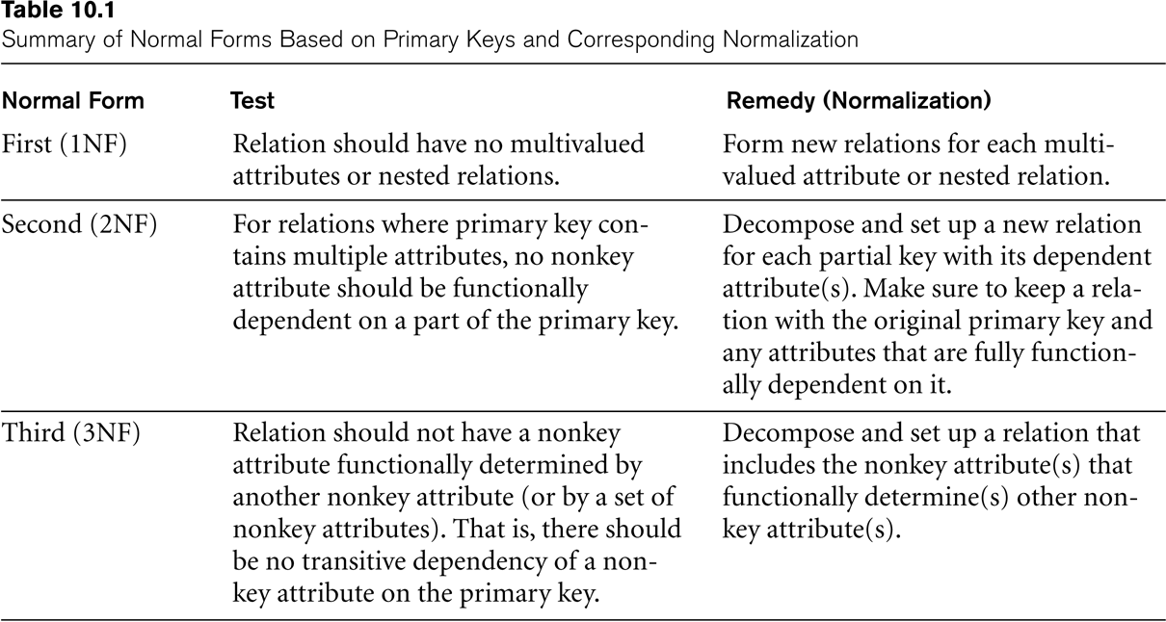
SUMMARY OF NORMAL FORMS based on Primary Keys

Slide 71
General Normal Form Definitions (For Multiple Keys)
The above definitions consider the primary key only
The following more general definitions take into account relations with multiple candidate keys
A relation schema R is in 2NF if every non-prime attribute A in R is fully functionally dependent on every key of R

Slide 72
General Normal Form Definitions
A relation R is in 3NF if whenever a FD X -> A holds in R, then either:
X is a superkey of R, or
A is a prime attribute of R
Notes:
Definition:
Superkey of relation schema R - a set of attributes S of R that contains a key of R

Slide 73
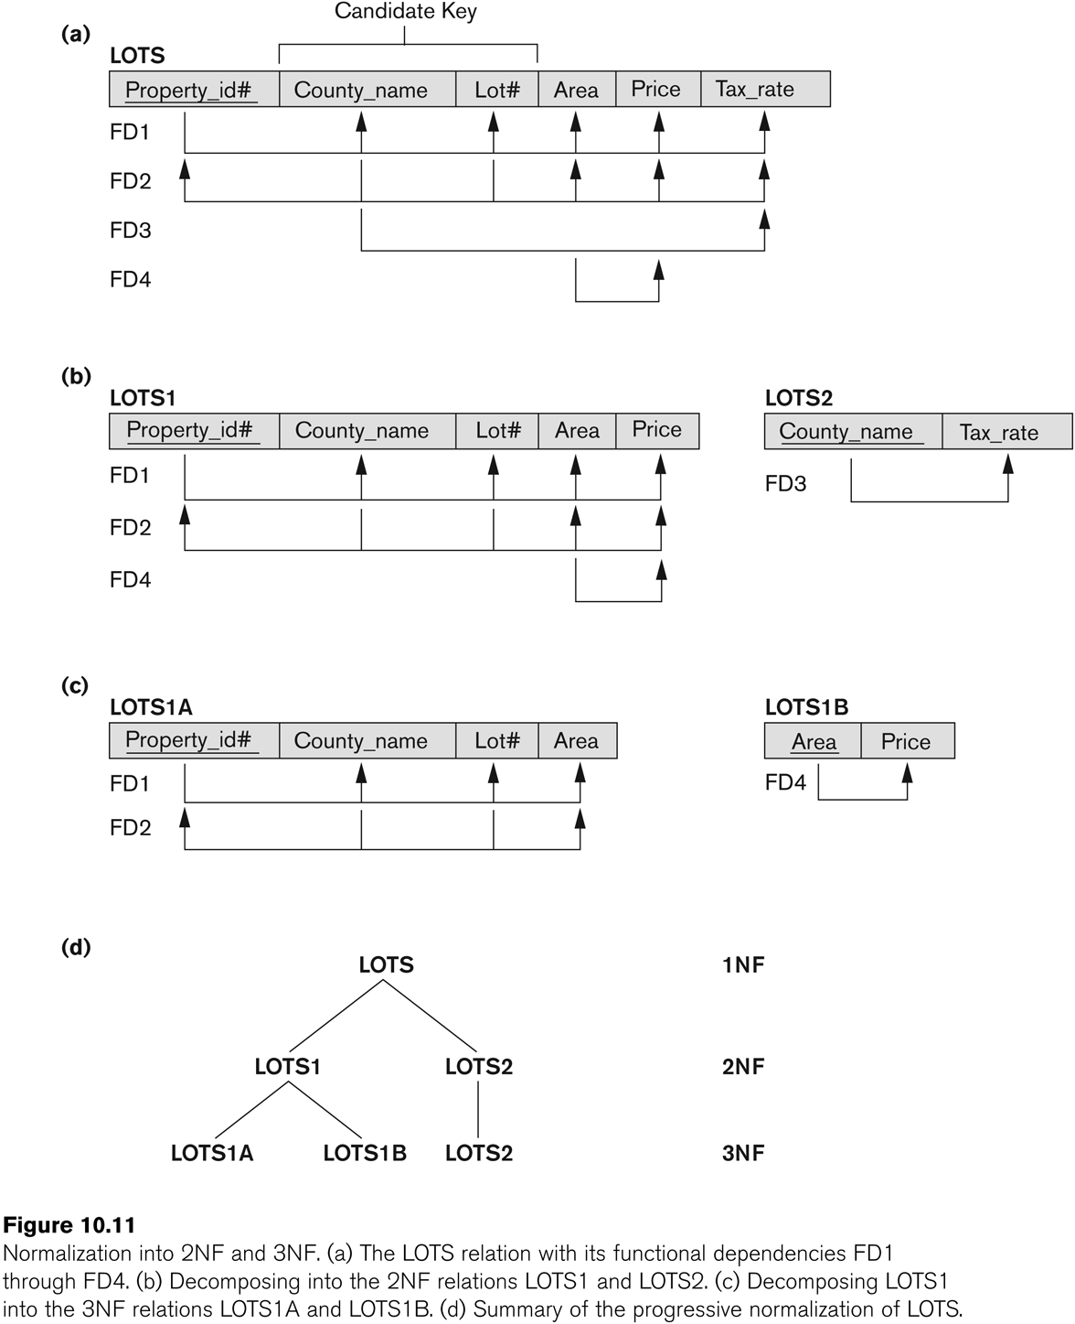
Successive Normalization of LOTS into 2NF and 3NF

Slide 74
BCNF (Boyce-Codd Normal Form)
A relation schema R is in Boyce-Codd Normal Form (BCNF) if whenever an FD X -> A holds in R, then X is a superkey of R
Each normal form is strictly stronger than the previous one
Every 2NF relation is in 1NF
Every 3NF relation is in 2NF
Every BCNF relation is in 3NF
There exist relations that are in 3NF but not in BCNF
The goal is to have each relation in BCNF (or 3NF)

Slide 75
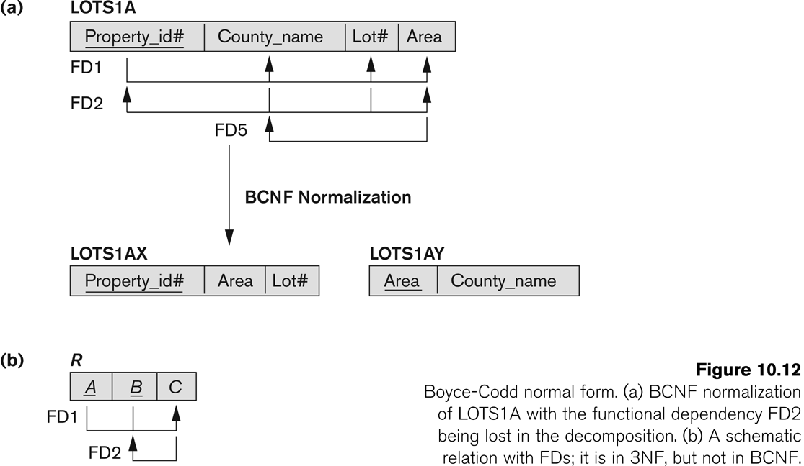
Boyce-Codd Normal Form

Slide 76
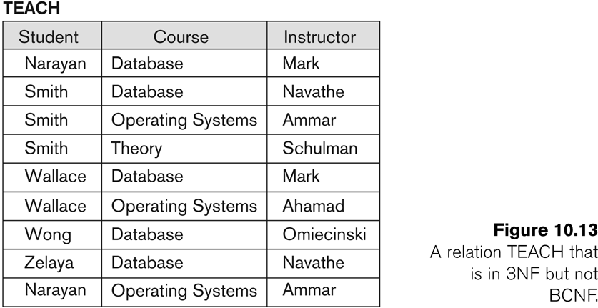
A relation that is in 3NF but not in BCNF
Two FDs exist in the relation TEACH:
FD1: { student, course} -> instructor
FD2: instructor -> course
{student, course} is a candidate key
Notes:
A relation NOT in BCNF should be decomposed so as to meet non-additive property, while possibly forgoing the preservation of all functional dependencies in the decomposed relations.

Slide 77
A relation that is in 3NF but not in BCNF
Two FDs exist in the relation TEACH:
FD1: { student, course} -> instructor
FD2: instructor -> course
Three possible decompositions for relation TEACH
{student, instructor} and {student, course}
{course, instructor } and {student, course}
{course, instructor } and {student, instructor}
{student, course} is a candidate key
All three decompositions lose FD1. We sacrifice the FD preservation. But cannot sacrifice the non-additivity property after decomposition.
Only the 3rd decomposition will not generate spurious tuples after join
Notes:
A relation NOT in BCNF should be decomposed so as to meet non-additive property, while possibly forgoing the preservation of all functional dependencies in the decomposed relations.

Slide 78
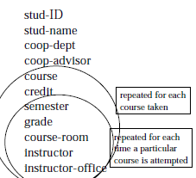
Example: Designing a Student Database
Students take courses
Students typically take more than one course
Students can fail courses and can repeat the same course in different semesters => Students can take the same course more than once.
Students are assigned a grade for each course they take.
The data that needs to be retained has repeating groups
Procedure: Remove repeating groups by adding extra rows to hold the
repeated attributes. => Add redundancy.

Slide 79
Designing a Student Database -2
Student_course(sID, sname, dept, advisor, course, credit, semester, grade, course-room, instructor, instructor-office)
1NF: Tables should have no repeating groups
Problems:
Redundancy
Insert anomalies
Delete anomalies
Update problems
Notes:
stud-ID -> stud-name, coop-dept, coop-advisor
Course -> credit
Semester -> course-room, instructor, instructor-office

Slide 80
Designing a Student Database -3
sname, dept, advisor are dependent only upon sID
credit dependent only on course and is independent of which semester it is offered and which student is taking it.
course-room, instructor and instructor-office only depend upon the course and the semester (are independent of which student is taking the course).
Only grade is dependent upon all 3 parts of the original key.
2NF: The non-prime attributes should depend on the whole key.
Procedure: remove partial key dependencies
Notes:
sID -> sname, dept, advisor
Course -> credit
Semester -> course-room, instructor, instructor-office
Stud-Id, Course, Semester -> grade
Instructor-> instructor-office

Slide 81
Designing a Student Database -4
Student_course(sID, sname, dept, advisor, course, credit, semester, grade, course-room, instructor, instructor-office)
Student (sID, sname, dept, advisor)
Student_Reg (sID, course, semester, grade)
Course (course, credit)
Course_Offering (course, semester, course-room, instructor, instructor-office)
2NF: There are no non-key attributes with partial key dependencies in any table.
Less redundancy
Still insert/delete/update problems

Slide 82
Designing a Student Database -5
3NF: The non-key attributes should not depend on other non-key attributes.
Procedure: remove non-key dependencies (transitive functional dependencies)

Slide 83
Designing a Student Database -3NF
Student (sID, sname, dept, advisor)
Student_Reg (sID, course, semester, grade)
Course (course, credit)
Course_Offering (course, semester, course-room, instructor, instructor-office)
Student (sID, sname, dept, advisor)
Student_Reg (sID, course, semester, grade)
Course (course, credit)
Course_Offering (course, semester, course-room, instructor)
Instructor (instructor, instructor-office)
More organized, Less redundancy (save space??)
performance problems?? (indirect references)

Slide 84
Designing a Student Database -7
In normalization, we are seeking to make sure that attributes depend:
on the key (1NF)
on the whole key (2NF)
on nothing but the key (3NF)
We have not checked whether some part of the key itself depends on a non-key attribute(s).

Slide 85
Designing a Student Database -8
Suppose:
each department may have more than one advisor
a advisor works for only one department (advisor -> dept)
a student may be associated with several departmental programs.
Student (sID, sname, dept, advisor)
Part of the compound key is determined by a non-key attribute
advisor -> dept
sname is function of only sID
dept is function of only advisor
Notes:
Advisor -> dept
Student (sID, sname)
Advisor (advisor, dept)
Student-Advice (sID, advisor)

Slide 86
Designing a Student Database -9
Student (sID, sname)
Advisor (advisor, dept)
Student-Advice (sID, advisor)
Student_Reg (sID, course, semester, grade)
Course (course, credit)
Course_Offering (course, semester, course-room, instructor)
Instructor (instructor, instructor-office)
BCNF: Table in 3NF and there are no dependencies of part of the compound key on another attribute

Slide 87

Normalization Example -- Sales Order
Fields in the original data table will be as follows:
SalesOrderNo, Date, CustomerNo, CustomerName, CustomerAdd, ClerkNo, ClerkName, ItemNo, Description, Qty, UnitPrice

Slide 88
Normalization: First Normal Form
Separate Repeating Groups into New Tables.
Repeating Groups Fields that may be repeated several times for one document/entity
The primary key of the new table (repeating group) is always a composite key;
Relations in 1NF:
SalesOrderNo, ItemNo, Description, Qty, UnitPrice
SalesOrderNo, Date, CustomerNo, CustomerName, CustomerAdd, ClerkNo, ClerkName

Slide 89
Normalization: Second Normal Form
Remove Partial Dependencies.
Note: Do not treat price as dependent on item. Price may be different for different sales orders (discounts, special customers, etc.)
Relations in 2NF
ItemNo, Description
SalesOrderNo, ItemNo, Qty, UnitPrice
SalesOrderNo, Date, CustomerNo, CustomerName, CustomerAdd, ClerkNo, ClerkName
Notes:
ItemNo -> Description
SalesOrderNo, ItemNo -> Qty, UnitPrice
SalesOrderNo -> Date, CustomerNo, CustomerName, CustomerAdd, ClerkNo, ClerkName
CustomerNo -> CustomerName, CustomerAdd
ClerkNo -> ClerkName

Slide 90
Normalization: Second Normal Form
What if we did not Normalize the Database to Second Normal Form?
Redundancy
Delete Anomalies
Insert Anomalies
Update Anomalies
Notes:
Repetition of Data – Description would appear every time we had an order for the item
Delete Anomalies – All information about inventory items is stored in the SalesOrderDetail table. Delete a sales order, delete the item.
Insert Anomalies – To insert an inventory item, must insert sales order.
Update Anomalies – To change the description, must change it on every SO.

Slide 91
Normalization: Third Normal Form
Remove transitive dependencies
Relations in 3NF
Customers: CustomerNo, CustomerName, CustomerAdd
Clerks: ClerkNo, ClerkName
Inventory Items: ItemNo, Description
Sales Orders: SalesOrderNo, Date, CustomerNo, ClerkNo
SalesOrderDetail: SalesOrderNo, ItemNo, Qty, UnitPrice
Notes:
ItemNo -> Description
SalesOrderNo, ItemNo -> Qty, UnitPrice
SalesOrderNo -> Date, CustomerNo, CustomerName, CustomerAdd, ClerkNo, ClerkName
CustomerNo -> CustomerName, CustomerAdd
ClerkNo -> ClerkName

Slide 92
Normalization: Third Normal Form
What if we did not Normalize the Database to Third Normal Form?
Redundancy – Detail for Cust/Clerk would appear on every SO
Delete Anomalies – Delete a sales order, delete the customer/clerk
Insert Anomalies – To insert a customer/clerk, must insert sales order.
Update Anomalies – To change the name/address, etc, must change it on every SO.

Slide 93
Chapter Summary
Informal Design Guidelines for Relational Databases
Functional Dependencies (FDs)
Definition, Inference Rules, Equivalence of Sets of FDs, Minimal Sets of FDs
Normal Forms Based on Primary Keys
General Normal Form Definitions (For Multiple Keys)
BCNF (Boyce-Codd Normal Form)

